Slide 1
Dijkstra's Algorithm
By Trace Comiskey, Michelle Mcaveety, KateLyn Miller, and Rylan Pietras

Slide 2
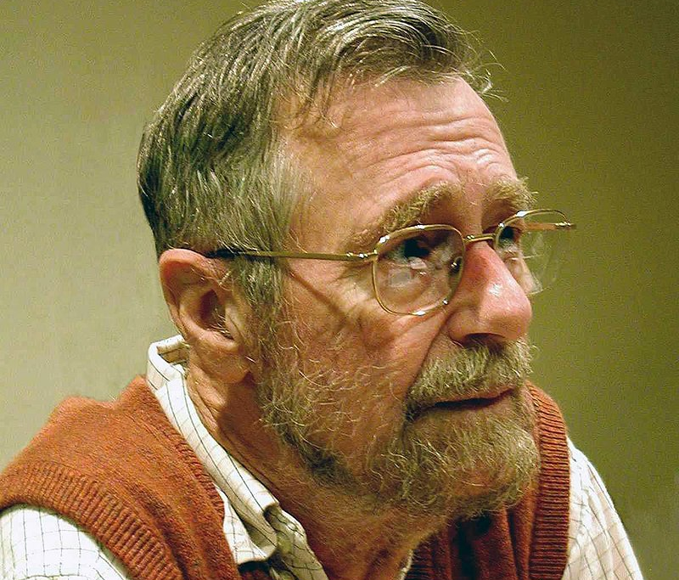
History of Dijkstra's Algorithm
Created by Edsger W. Dijkstra in 1956
Initially conceived as a procedure for finding the shortest path between two cities
Very similar but unrelated to the much earlier Prim's Algorithm
Edsger Dijkstra, 2002

Slide 3
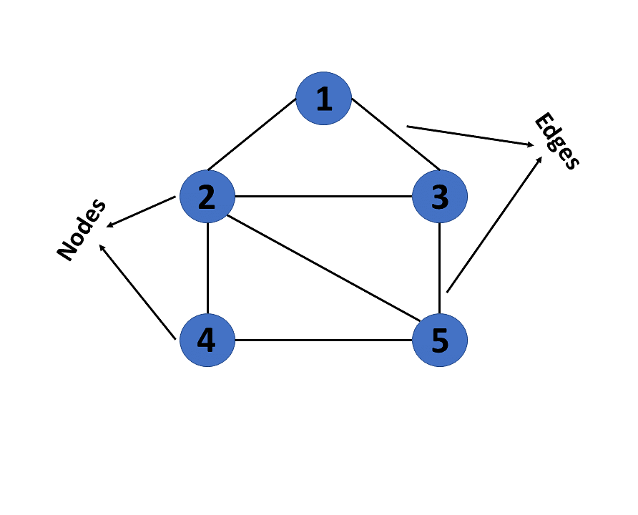
Graph Theory
All graphs consist of nodes, called vertices, and edges connecting the vertices
Each vertex, has a different label identifying it
Can be stored in multiple ways:
Adjacency Matrices
Adjacency Lists
Edge lists

Slide 4
Function of Dijkstra's Algorithm
Searches a graph with weighted edges for the shortest possible path and distance between two vertices
Shortest path is all vertices traveled to from one vertex to another that results in the shortest total distance
Shortest distance is found through summing the weight of edges along shortest path
Used in a variety of tasks, but often superseded by more modern algorithms
Used in link-state routing protocols, OSPF, and IS-IS
Served as noteworthy base for multiple algorithms
The A* pathfinding algorithm is a derivation of Dijkstra's

Slide 5
Steps of Dijkstra's Algorithm
vertex selection
Shortest path storage
Each vertex starts as unexplored
The unexplored vertex with the shortest path from the starting vertex is selected (including starting vertex if at beginning)
When a vertex is selected, it is marked as explored
After a vertex is marked as explored, its adjacent vertices (neighbors) distance values are updated (follow steps in Shortest Path Storage)
Each vertex in the graph has an initial value of infinity
Checks each adjacent vertices' (neighbors') distance values
If the neighbor's value is greater than the value of the current vertex plus the edge between them (estimate), the neighbor's value is set to the estimate, and the neighbor is given a pointer back to the current vertex
This process repeats until the target node is selected and it's distance value is determined

Slide 6
Our Implementation of Dijkstra's Algorithm
Graph data structure implemented via adjacency list
Interface allows for custom graph creation
Each vertex is stored as Vert object, and each edge is stored as Neighbor object
All Vert objects are stored within a vector (graph)
All Neighbor objects are connected to Vert objects as linked lists
Each Neighbor object represents an adjacent vertex to the Vert object
Heap priority queue used to select next unexplored vertex with shortest path to the starting vertex
Our function takes two strings representing the labels of two vertices as input, as well as a vector to store the shortest path
The inputted vector stores the vertices making up the minimum path between the two inputted vertices.
Returns the length of the shortest path between the two vertices

Slide 7
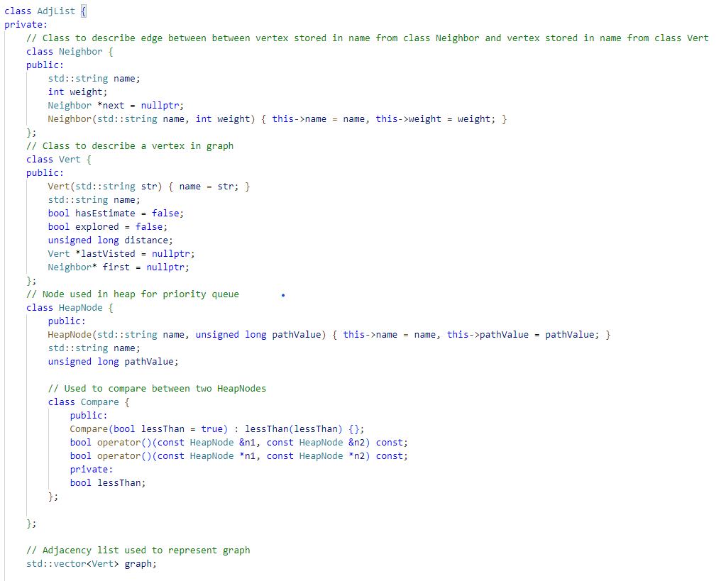
Graph Adjacency List Implementation
Stores vertices in class Vert objects, held in vector "graph"
Stores edges in class Neighbor objects
Includes methods for adding and removing vertices and edges
Includes methods for printing and clearing graph, as well as destructor

Slide 8
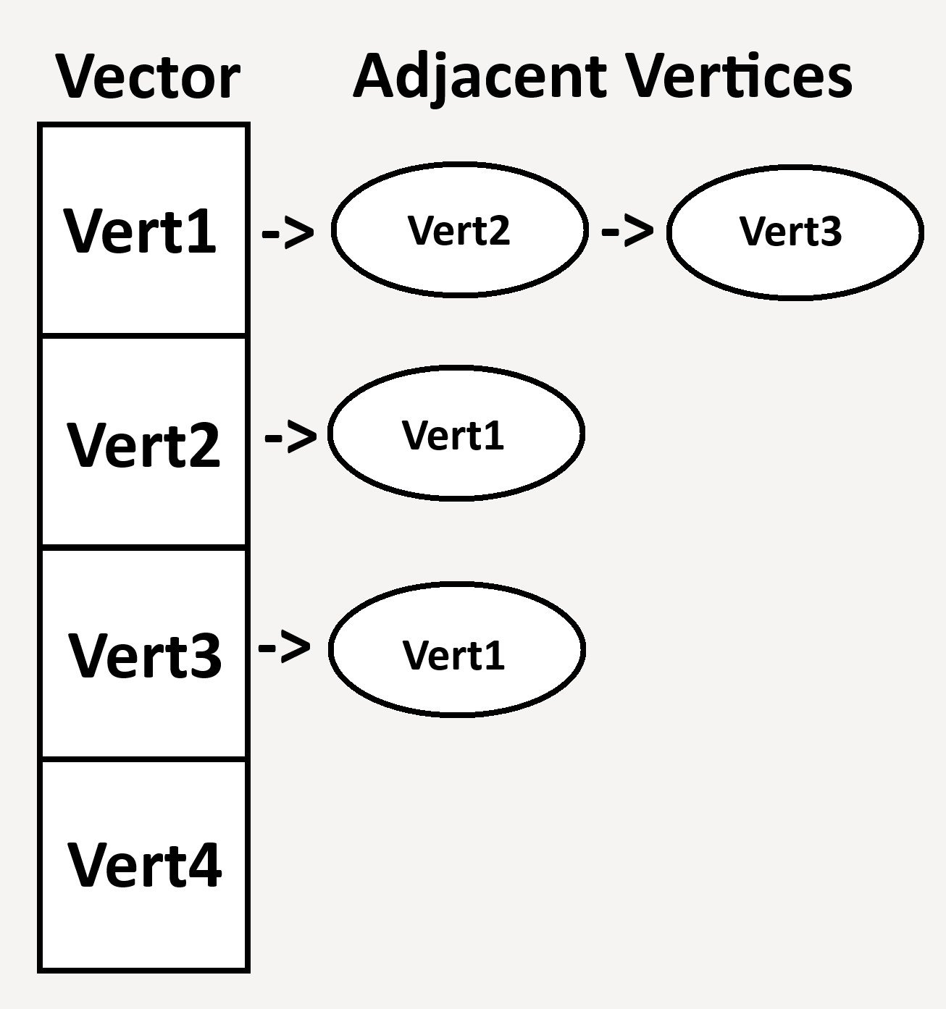
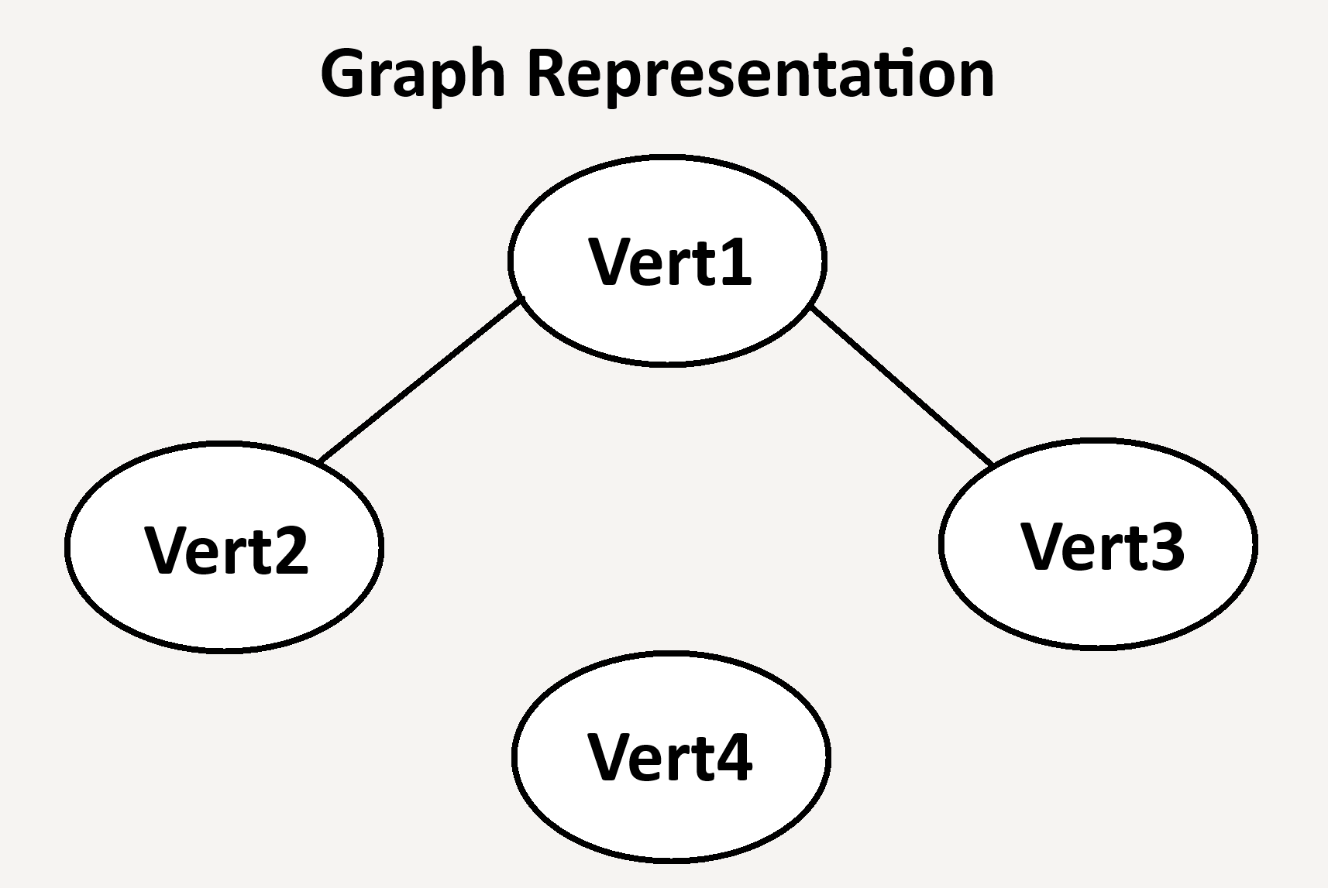
Example Adjacency List & Graph Representations

Slide 9
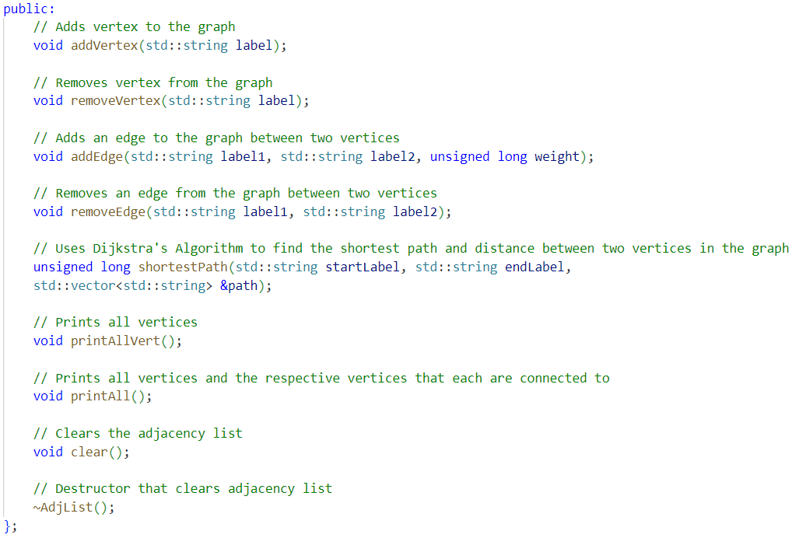
Adjacency List Methods Implemented
addVertex/addEdge – Used to build a graph with vertices and connecting edges
removeVertex/removeEdge – Used to remove the vertices and edges of a graph
printAllVert – Prints all vertices within current graph
printAll – Prints all vertices and their associated adjacent vertices
clear – Completely removes all vertices and edges of current graph
~AdjList – Destructor for AdjList objects
shortestPath – Uses Dijkstra’s Algorithm to find the shortest path and distance between two vertices. The distance is returned, and the path is stored in the vector “path”

Slide 10
Shortest Path Priority Queue Heap Implementation
Vector based min heap priority queue — each node stores the label of a vertex and its estimated minimum path to the starting vertex
Node on top of min heap is next to be selected. If node is already explored, it is removed, and the next node is selected
Each time a node is selected, it is marked as explored, the last selected node is saved, and the label and path length of each neighbor is updated and added to the heap
This process allows the minimum path and distance to be found from the starting vertex branching out to every other vertex

Slide 11
Bibliography
Bhattacharyya, Soumalya. “How Is Dijkstra’s Algorithm Used in the Real World? | Analytics Steps.” Www.analyticssteps.com, 11 Sept. 2023, www.analyticssteps.com/blogs/how-dijkstras-algorithm-used-real-world.
geeksforgeeks. “What Is Dijkstra’s Algorithm? | Introduction to Dijkstra’s Shortest Path Algorithm.” GeeksforGeeks, 10 Mar. 2023, www.geeksforgeeks.org/introduction-to-dijkstras-shortest-path-algorithm/.
Spanning Tree. “How Dijkstra’s Algorithm Works.” YouTube, 15 Aug. 2020, youtu.be/EFg3u_E6eHU?si=NE3N3pUYu0Je6UOr. Accessed 24 Nov. 2024.
Wikipedia Editors. “Dijkstra.” Wikipedia, 26 Oct. 2019, en.wikipedia.org/wiki/Dijkstra.

Slide 12
Live Demo

